Slide 1
ACCY577 Machine Learning for Accounting
Module 5: Model Optimization
Linden Lu

Slide 2
Module 5: Model Optimization
Feature Selection
Cross Validation
Feature Selection

Slide 3
ACCY577 Machine Learning for Accounting
Module 5: Model Optimization
Lesson 1: Introduction to Feature Selection

Slide 4
Lesson 1: Feature Selection
Key benefits
Reduces Overfitting
Improves Accuracy
Reduces Training Time
Improves Interpretability

Slide 5
Feature selection algorithms
Filter methods
Wrapper methods
Embedded methods

Slide 6
Filter Methods
Variance Threshold
Rank features by variance
Feature Scaling is necessary
Doesn't use target feature
Univariate Techniques
Rate features individually
Relationship between individual feature and target feature

Slide 7
Wrapper methods
Recursive Feature Extraction

Slide 8
Embedded Methods
Rank features during training
Model dependent
Decision Tree
Random Forest

Slide 9
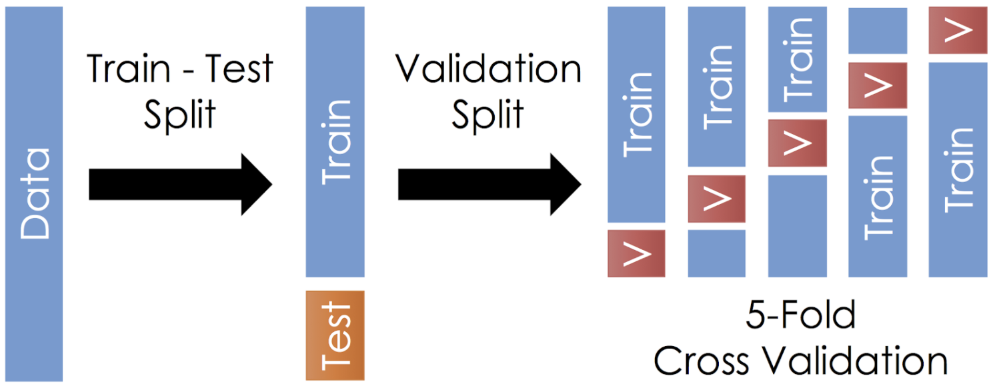
Lesson 2: Introduction to Cross Validation
Train Test Split vs. Cross Validation

Slide 10
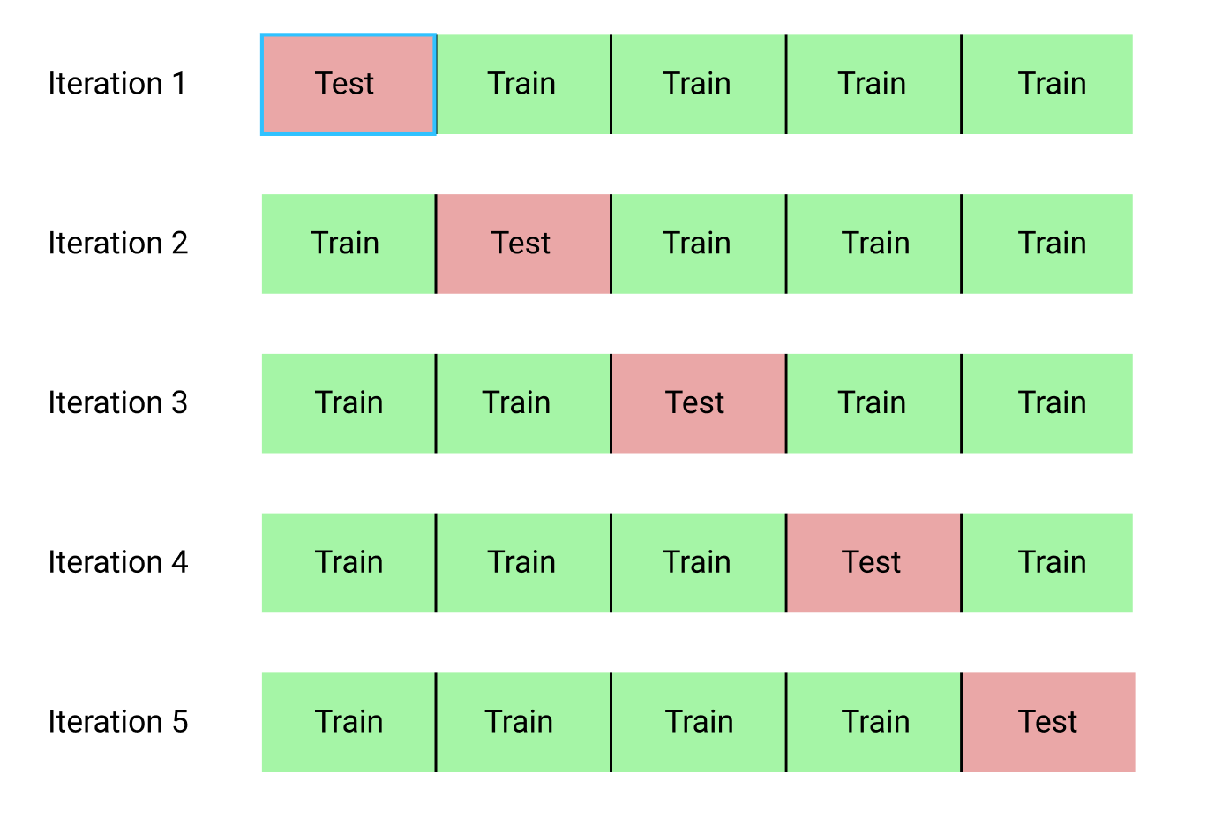
KFold

Slide 11
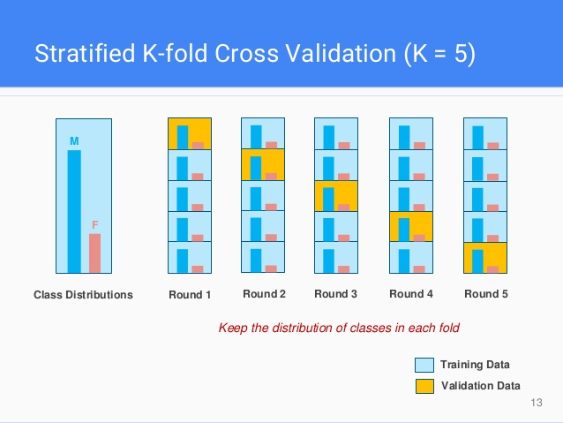
Stratified KFold

Slide 12
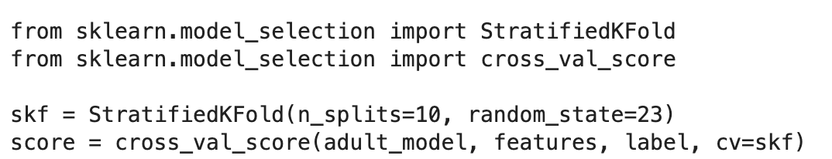
Evaluate Model with Cross-Validation

Slide 13
Custom Scoring

Slide 14
Lesson 3: Model Selection with Cross Validation
Grid Search
Random Grid Search

Slide 15
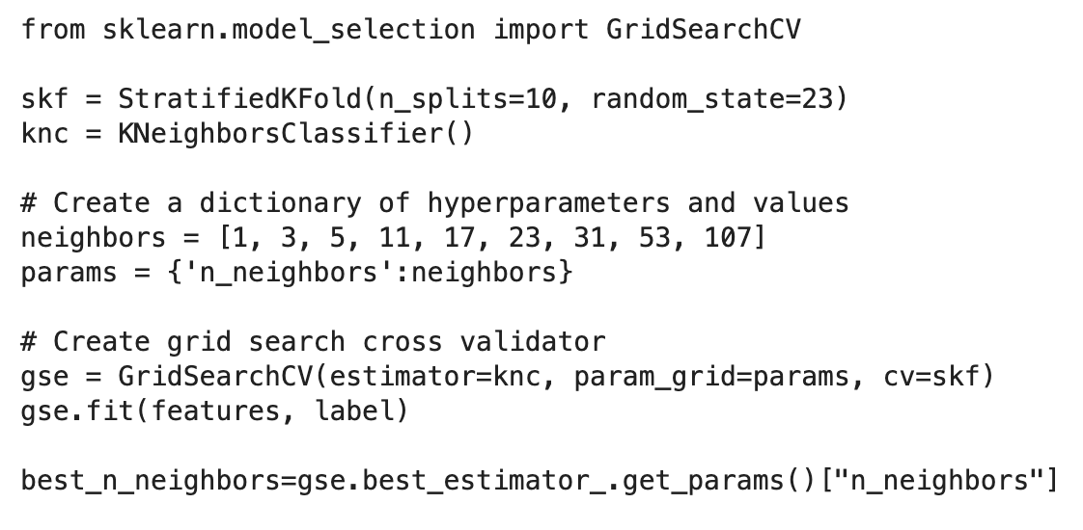
Grid Search

Slide 16
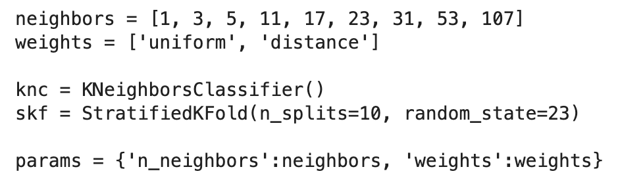
Multi-dimensional Grid Search

Slide 17
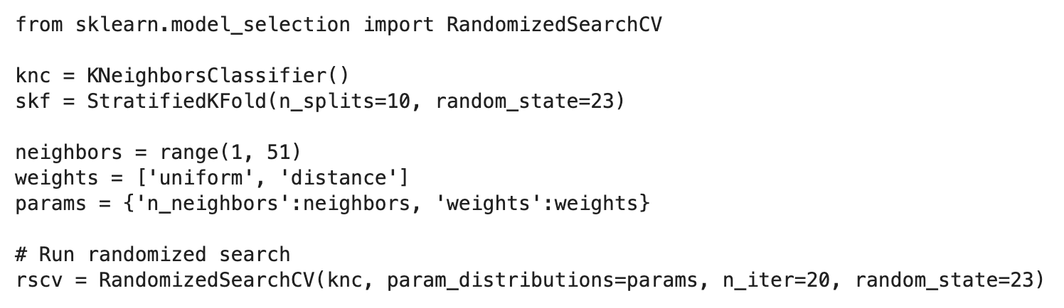
Randomized Grid Search

Slide 18
Module 5: Model Optimization Review
Feature Selection
Filter Methods
Wrapper Methods
Embedded Methods
Cross Validation
KFold
StratifiedKFold
Model Selection
Grid Search
Randomized Grid Search

